Slide 1


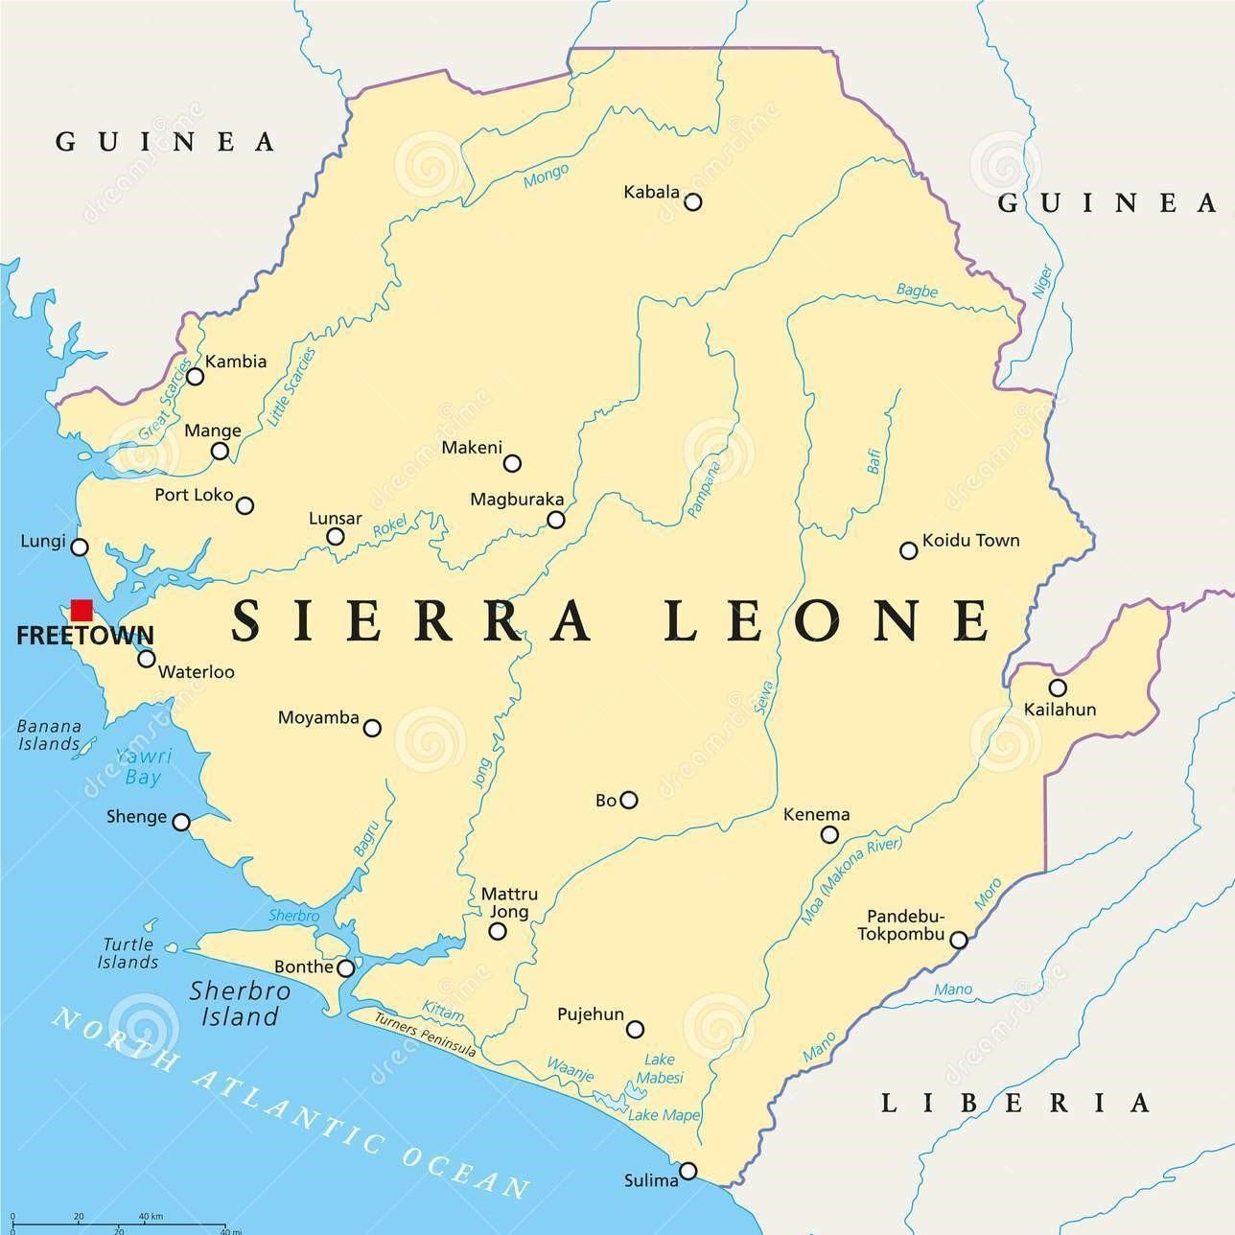
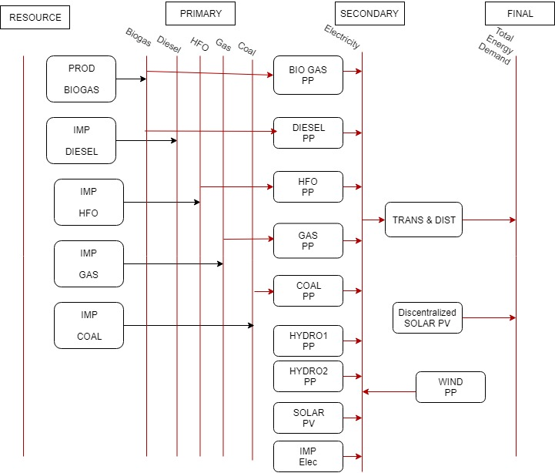

Sierra Leone: National Electrification with Power Generation Resilience to Climate Change
Summer School on Modelling Tools for Sustainable Development – OpTIMUS, 10 – 28 June, ICTP, Trieste
Author(s): Dr. Samba Sesay; Dr. Michael. A. Conteh; Dr. David Caulker
Affiliation(s): Fourah Bay College. University of Sierra Leone (USL)
1. Context
2. Aim
Sierra Leone is endowed with abundant Renewable Energy Potential, mainly Hydro and Solar, but facing severe energy scarcity. Only 17.8% of its population of 7million people has axcess to Electricity and the Mining companies and other heavy power industries are not connected to Grid. The rate of Electrification is 14%. All of the above stall the Socio Economic Development of the nation.
The aim of this study is to investigate the amount of investment needed and the energy mix required for Sierra Leone to meet with its SDG 7.1. commitment of ensuring universal access to affordable, reliable and modern energy by 2030. The resilience of Power Generation to climate change and delayed Hydro Development is also considered.
3. Methods & Scenarios
Figure 1. Map of Sierra Leone
4. Results
Scenarios were modeled in OSeMOSYS, which is a generator that selects suitable energy mix to provide least-cost optimal solutions.
National Electrification: Proposed rate of Electrification are 60% by 2025, 80% by 2030 and 100% by 2035.
Delayed Hydro: Phase 2 of Bumbuna the main hydro facility in the country introduced in 2027 compared to 2020 in base case
Climate Resilient: Experiencing intermittent drought in several years of the modelling period.
Figure 2. Sierra Leone Reference Energy System.
5. Policy insights, conclusions and future work
6. References
Conclusions: At the Base case rate of electrification, even in 2050, only 58% of the population will have access to Electricity. For the National Electrification Scenario, Universal Access will be achieved in 2035. If Sierra Leone should develop, high investment needs to be made in the energy sector. Extra 2.2 Billion USD in Total Investment is needed to meet National Electrification Target. Moreover for power generation that is climate resilient extra 5 Million USD is required over that for base case.
Policy insights: To meet the increase in demand projection for national electrification. Investing in VRES including run off hydros provides an ecomomical and effective approach. However the study shows that investment in large hydro with with Dams is not an economically viable option.
Future work: In the future Regional Integration for Import and export of electricity will be modelled and other scenarios like high fossil fuel price runned. Develop Course Program for Energy Modelling Systems
[1] ATILA Data on Sierra Leone
[2]https://www.irena.org/documentdownloads/publications/wapp.pdf
[3]http://www.epa.gov/climatechange/EPAactivities/economics/nonco2projections.html
[4] Temba Data on Sierra Leone
Contact: Dr. Samba Sesay Email: sambasey@gmail.com
A Cost-benefit analysis of Policy, Programs and Projects (C3PO) that is Retrievable, Reusable, Repeatable, Reconstructible, Interoperable and Auditable (u4RIA)

